Slide 1
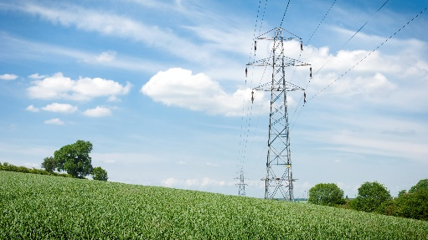
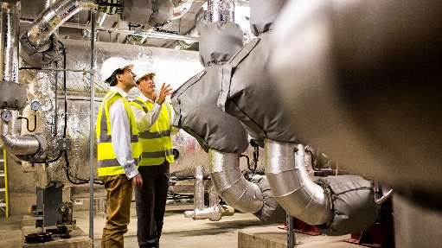
E.ON – a major European Grid Operator and Energy Group
E.ON
15 countries
~78.000 employees
41.5 bln € turnover
Energy grids
European Network Operator #1
>500.000 connected assets
1.6 Mio. km energy networks
Customer Solutions
Leading European energy supplier
~51 Mio. customers
Energy Infrastructure Solutions
>500.000 heat customers
6000 employees
>5700 asset / 5000 km grids
500 – 650 Mln. € Invest p.a.

Slide 2
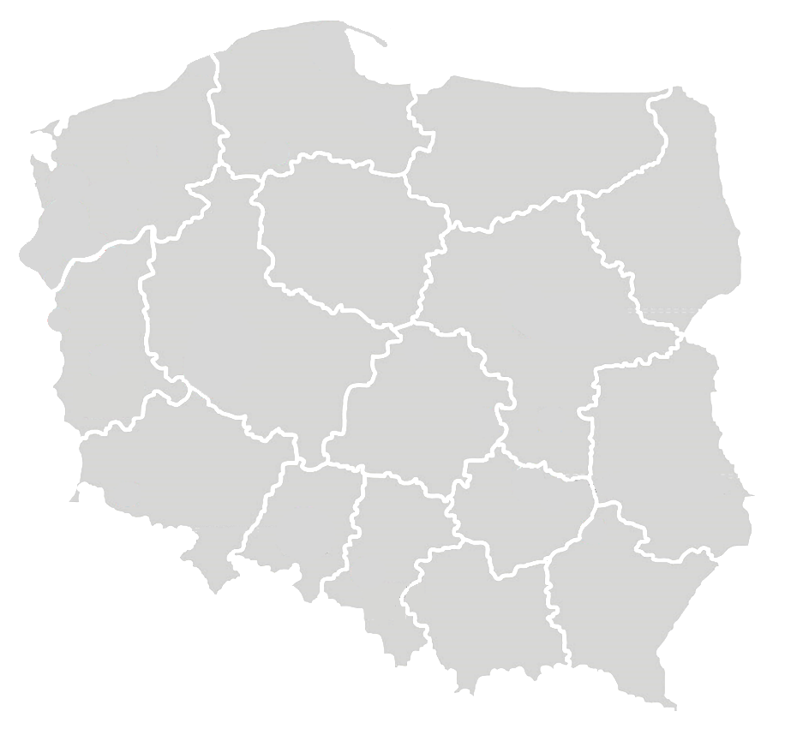
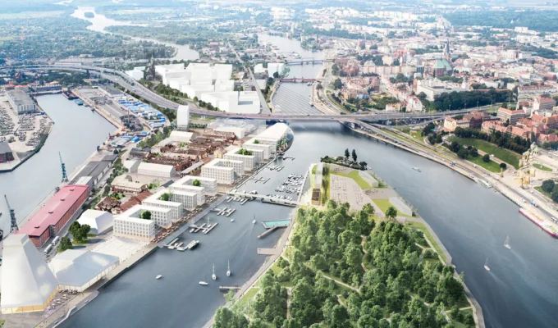
E.ON Infrastructure Solutions with a nation-wide footprint in Poland
General numbers*
Employees | ~ 750
Grids in 29 cities | ~ 570 km
Heat, cold – sales | 1.6 TWh
Power sales | 30 GWh
Generation ( today) | ~70 % coal
Szczecin
Barlinek
Dębno
Łobez
Myślibórz
Połczyn-Zdrój
Słubice
Strzelce Krajeńskie
Choszczno
Chojnice
Zgorzelec
Warszawa
Jarocin
E.ON Polska
E.ON edis energia
STOEN Operator
E.ON Polska Solutions
E.ON Polska Operations
E.ON Foton
*) ECO not included as 46% minority position
Skarżysko-Kamienna
Świebodzice
*
Opole
Sokółka
Grójec
Drzewica
Starachowice
ECO Malbork
ECO Kutno
ECO Jelenia Góra
ECO Tarnobrzeg
ECO Kogeneracja
ECO Logistyka
ECO Serwis
ECO Ciepło Lokalne 1
Świebodzice
* In General Numbers, we do not include data from ECO (minority shareholding - 46,7%)

Slide 3
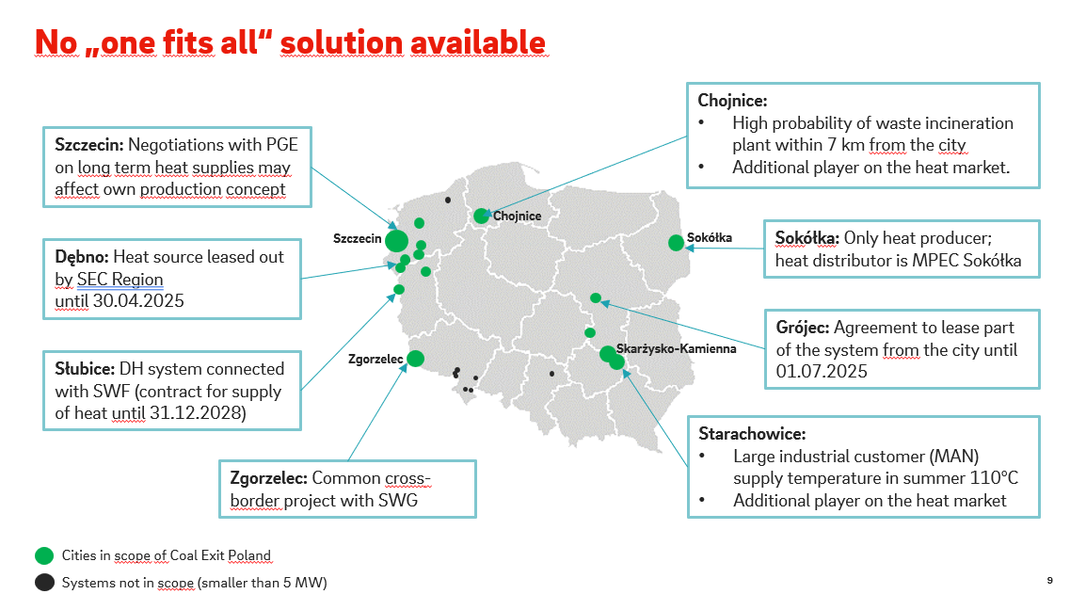
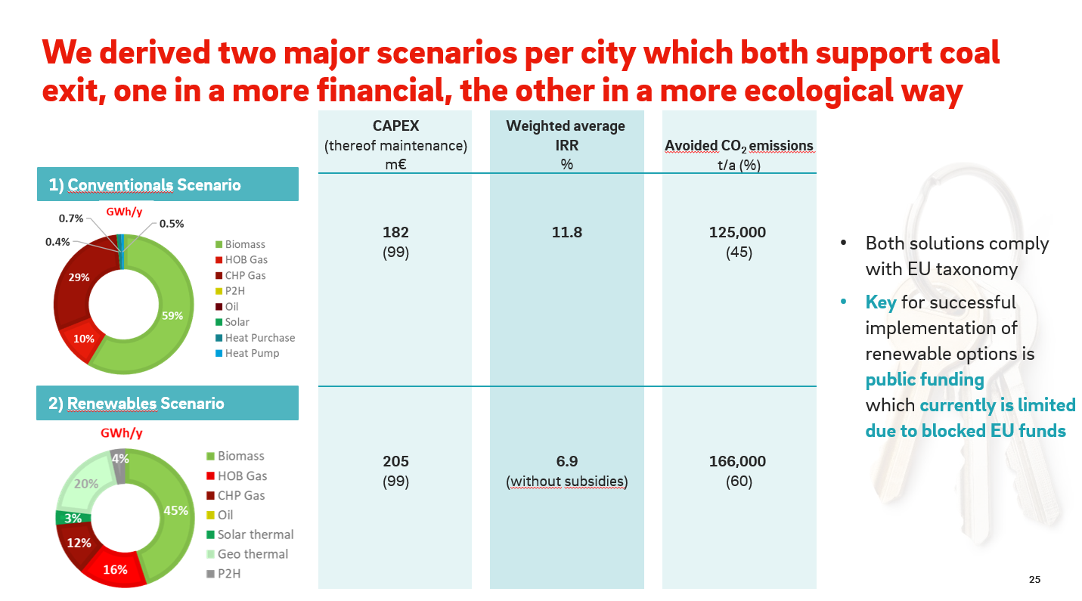
Replace all coal-based generation by 2030
Coal Exit
No stranded fossil energy-based assets in 2035
Fulfil Polish and EU environmental regulation
Investment Volume E.ON is prepared to spent > 200 mEUR
Saving 166,000 tons of CO2 p.a. = all Lufthansa flights to and from Poland
> 8 %
< 7%
Range of solutions considered
RES | Biomasse
Solar thermal Geothermal Heat pump | HOB biomass ORC biomass
Electric | Gas
Electric boiler | HOB gas CHP gas
+ Optimisation of existing grids: digitisation, grid temperature reduction, storage tanks, grid accumulation
5,5% threshold, expenses per household

Slide 4
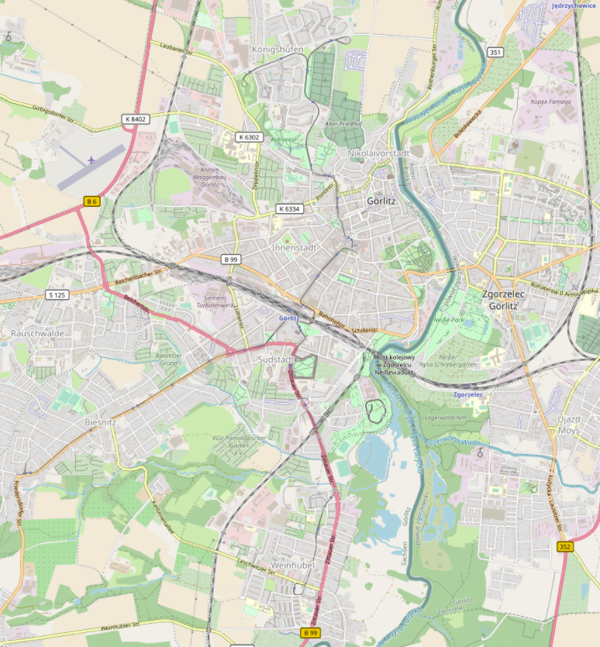
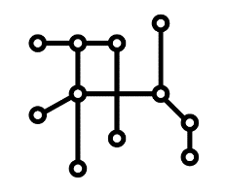
Climate-neutral district heating in the Görlitz Zgorzelec A crossborder lighthouse project
Königshufen
Wärmemenge: 60 GWh
1,1 km
1,3 km
5,0 km
Zgorzelec
Wärmebedarf: 65 GWh
Rauschwalde
Wärmemenge: 8,9 GWh
Construct 12 km of DH pipelines on both sides
A renewed set of generation plants in both Görlitz and Zgorzelec
Combination of Low Carbon Technologies incl. biogas, biomass, PV, HP, solar thermal, heat storage
Goethestraße
Wärmemenge: 4,2 GWh
Cross Border Cooperation between 2 EU countries, 2 cities and 2 major European Energy Companies Veolia and E.ON
Application for funding under EU-Program CEF 2 Energy (Connecting Europe Facility) Cross-Border Renewable Energy filed
Possibility to connect new customers to low carbon DH system retaining affordable pricing
2,5 km
Weinhübel
Wärmemenge: 17,3 GWh
2,0 km
DH areas
Possible locations for new plants
New pipes

