Slide 1
2. Deutsch-Polnisches Energiewendeforum
German heating transformation policy explained – how are social issues addressed?
Carla Vollmer
Fachgebiet V 1.3 - Erneuerbare Energien

Slide 2
Outline
German heating transformation policy explained – how are social issues addressed?
1 Renewable Heating in Germany – Status Quo
2 Support systems for the roll-out of renewable heat and social responsibility
2.1 Heat Planning Act
2.2 Building Energy Act
2.3 Social component in the support systems for the roll-out of renewable heat
2.4 Social dimension/ aspects of CO2 pricing in Germany
3 UBA RECOMMENDATIONS FOR THE IMPLEMENTATION OF SUPPORT PROGRAMMES FOR VULNERABLE HOUSEHOLDS

Slide 3
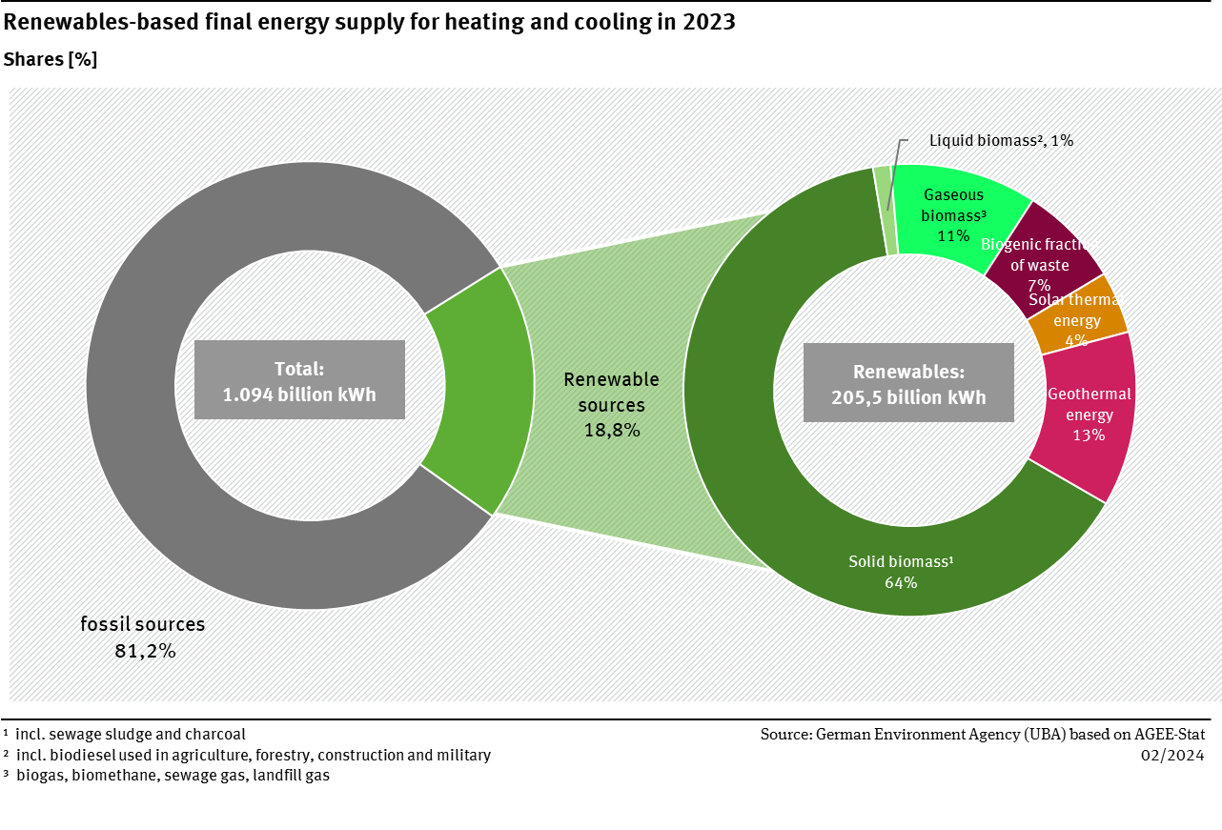
Renewable Heating in Germany – Status Quo
German heating transformation policy explained – how are social issues addressed?
→ The share of renewable energy sources in final energy consumption for heating and cooling increased in 2023, reaching 18.8 % after 17.5 % in 2022.

Slide 4
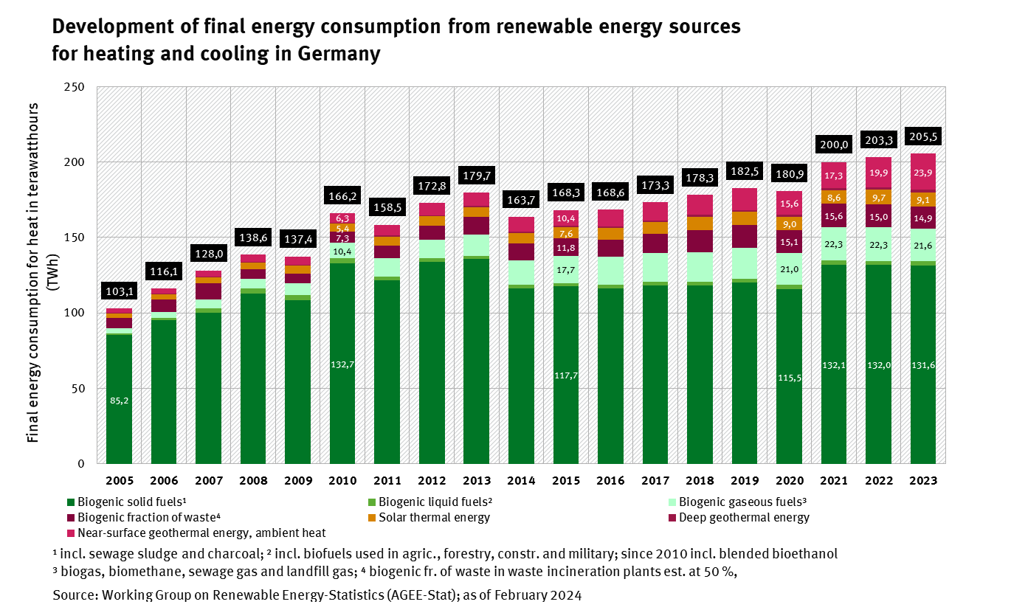
Renewable Heating in Germany – Status Quo
German heating transformation policy explained – how are social issues addressed?
→ The consumption of renewable heat increased only slightly from 203.3 billion kWh (2022) to 205.5 billion kWh (2023), while the consumption of fossil fuels for heat fell significantly at the same time

Slide 5
Regulatory framework
German heating transformation policy explained – how are social issues addressed?
Heat Planning Act (Kommunales Wärmeplanungsgesetz)
→ different deadlines to finish a heating plan according to the size of the municipality
Municipalities up to 100.000 inhabitants until 30.06.2028
Municipalities above 100.000 inhabitants until 30.06.2026
Building Energy Act (Gebäudeenergiegesetz): minimum 65 % renewable Energy or unavoidable waste heat
Immediately in force for new built buildings
Existing buildings:
Applicable from mid 2026 / mid 2028 in municipalities with more / less than 100.000 inhabitants
one month after the approval of an heating plan
longer deadlines for the implementation of district heating or green gas networks
Building Energy Act (Gebäudeenergiegesetz): from 2045 on Operation ban of central heating boiler with fossil fuels

Slide 6
Social component in the support systems for the roll-out of renewable heat
German heating transformation policy explained – how are social issues addressed?
Federal Funding for Efficient Buildings (Bundesförderung für effiziente Gebäude)
programme offers financial incentives, such as grants and subsidies, to individuals and companies undertaking renovations or constructions that improve energy efficiency
funding covers various measures, including the installation of sustainable heating systems, insulation improvements, and the installation of energy-efficient windows and doors
KFW Subsidy No. 458 "Heating subsidy for private individuals – residential buildings”
Up to 70% of investment can be subsidised (different components can be accumulated up to 70%)
individual measures | Basic Funding | Efficiency Bonus | Climate Acceleration Bonus | Income Bonus
Solar Thermal Systems | 30% |  | 20% | 30%
Heat Pumps | 30% | 5% | 20% | 30%
…
→ owner-occupied property is eligible for the income bonus if your household annual income is a maximum of €40,000

Slide 7
Social dimension/aspects of CO₂ pricing in Germany
German heating transformation policy explained – how are social issues addressed?
Fuel Emissions Trading Act (Brennstoffemissionshandelsgesetz)
National emissions trading system (nEHS) in force since 2021: introduced CO₂ emissions pricing in the heating and transport sectors (fixed price for one tonne of CO₂ amounts to 45 euros in 2024)
The price of 45 euros per tonne of CO₂ corresponds to an increase of 0.8 cents per kW/h in the price of natural gas and 12 cents per liter in the price of heating oil
Revenues from the sale of nEHS certificates flow into the Climate and Transformation Fund (KTF) (2023: 10.7 billion euros)
Carbon Dioxide Cost Sharing Act (Kohlendioxidkostenaufteilungsgesetz)
In force since 2023: in rented buildings, CO₂ costs incurred for heating oil, natural gas and other fuels must be shared between the landlord and tenant
Cost sharing according to a phased model intended to encourage tenants to adopt energy efficient behavior and landlords to carry out energy efficient renovations

Slide 8
UBA recommendations for the implementation of support programmes for vulnerable households
German heating transformation policy explained – how are social issues addressed?
Specific support programes for vulnerable households must complement other approaches
the recently adopted EU ETS for fuels (EU ETS 2) will start in 2027. Significantly rising CO2 prices are possible and can be expected in the course of the transition to the EU ETS 2.
a substantial part of the CO2 revenues should be refunded to households
some households particularly affected by CO2 pricing are considered vulnerable and are particularly affected by fossil energy price increases. They have a structurally high fossil energy demand while at the same time only a low income.
this applies, for example, to households living in poorly insulated apartments and using oil or gas heating systems, or to long-distance commuters who have to drive to work in a fossil fuel car for lack of alternatives.
the state should launch or expand specific efficiency and decarbonisation measures support programmes for such households together with a climate dividend.
The climate dividend should be high enough to relieve the lower income strata on average. The incentives for households to take energy efficiency measures or switch to non-fossil energies are retained. This is because those who emit less CO2 retain a higher net proportion of the climate dividend.
However, not only can the climate dividend compensate for income losses due to the CO2 price, it also creates additional scope in households for financing efficiency and climate protection measures in addition to mentioned specific support programmes.
Corresponding approach: Develop and provide low-interest loans (backed-up by federal guarantee) primarily for low-income households who can not always contribute the investment costs that remain after ‘conventional’ funding cf. https://deneff.org/deneff-downloads/policy-paper-finanzinnovationen-fuer-die-waermewende/ and https://www.umweltbundesamt.de/publikationen/waermepumpensysteme-in-bestandsgebaeuden

Slide 9
Thank you very much for your attention!
Carla Vollmer
carla.vollmer@uba.de
Umweltbundesamt
Wörlitzer Platz 1
06844 Dessau-Roßlau
www.uba.de/

