Slide 1
Regulatory Framework and Status of Implementation
Mariusz Skwarczynski, Ph.D. Eng. P.E.
Project Manager
Innovative Program Management
Development Department
The National Centre for Research and Development

Slide 2
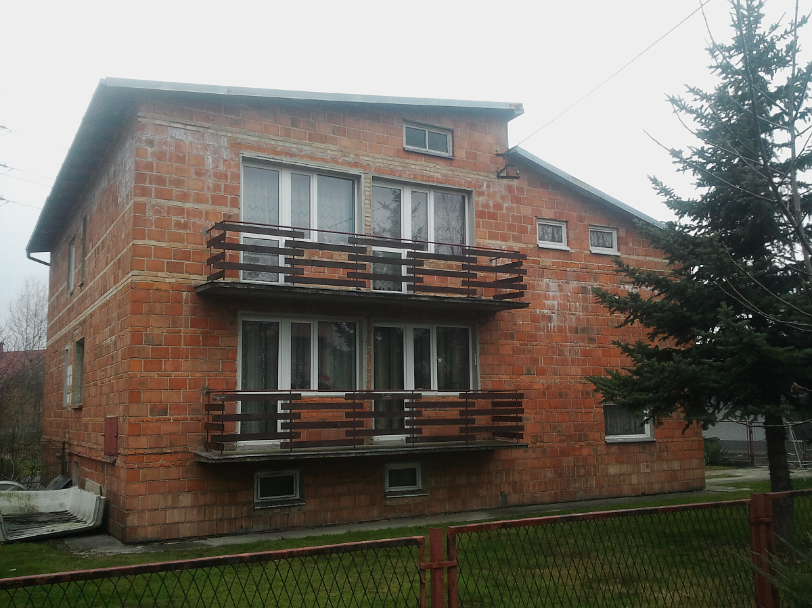
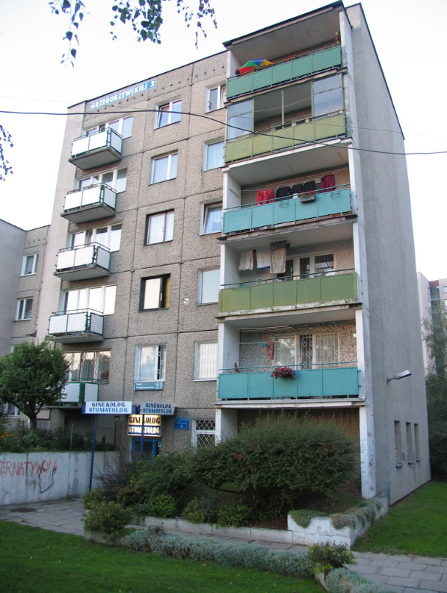
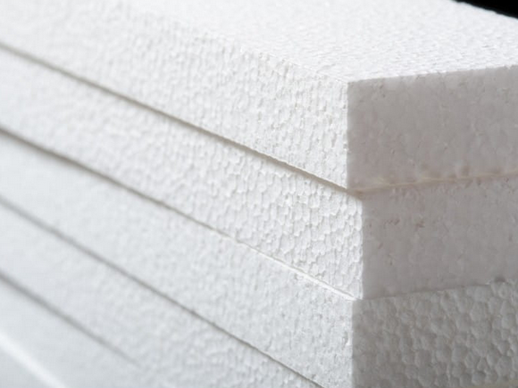
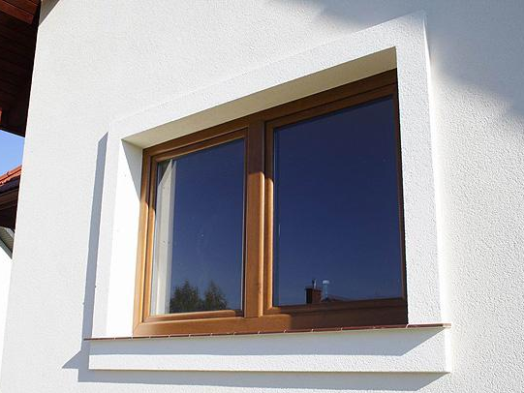
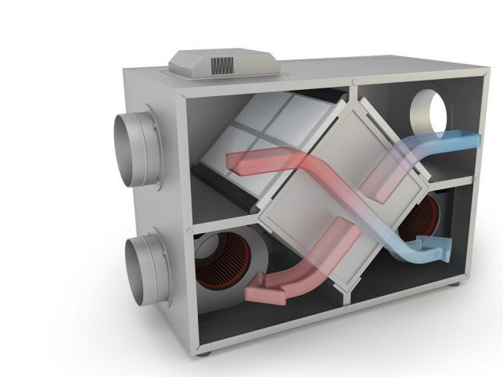
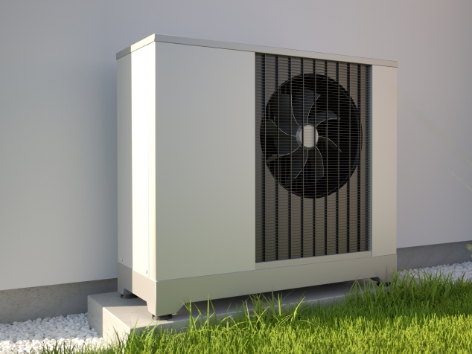
2nd German-Polish Energy Transition Forum, Berlin, 17th May 2024
FIRST STEP: DEEP THERMAL MODERNIZATION OF BUILDINGS
6.3 MILLION
0.6 MILLION
One of the elements of the energy transformation is the revitalization of buildings. The goal is to reduce the amount of energy needed for heating to 25% of current levels. To perform this task, you need qualified installers, but above all, a large number of materials and many installation systems.
For the 30% of the most difficult buildings need:
150 MCM
90 MCM
5 MILLION
3 MILLION

Slide 3
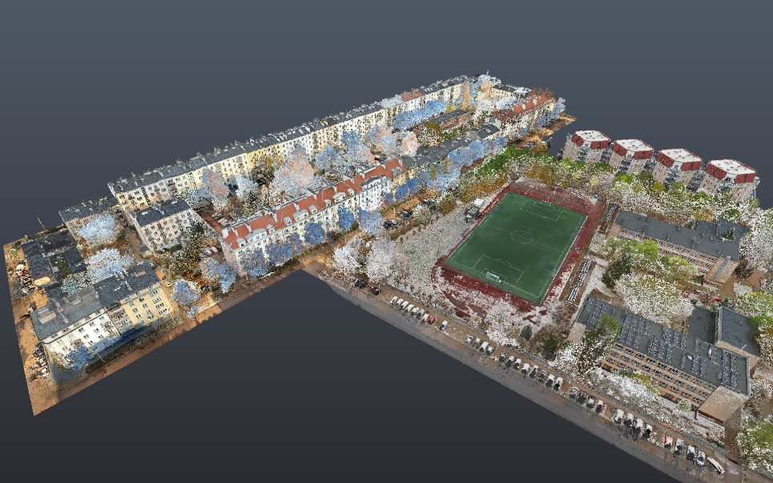
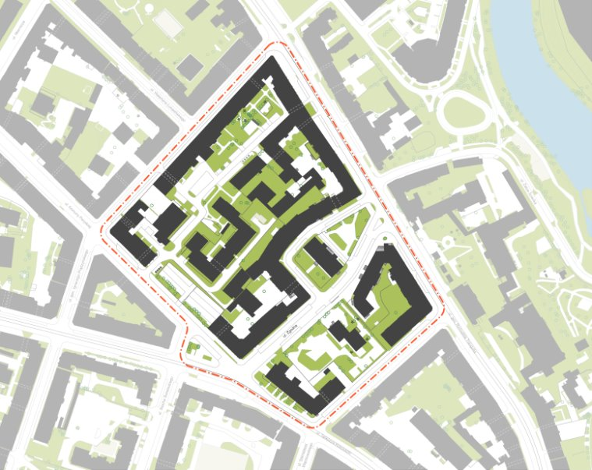
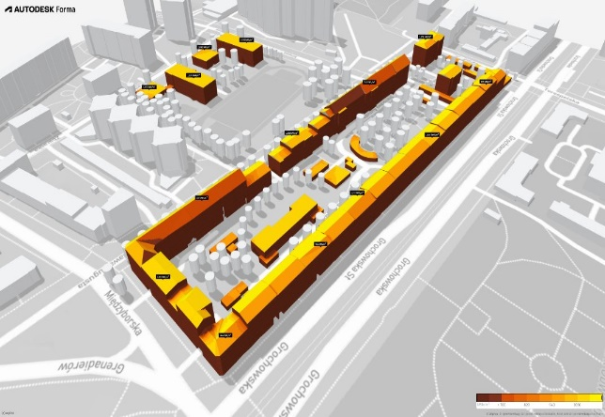
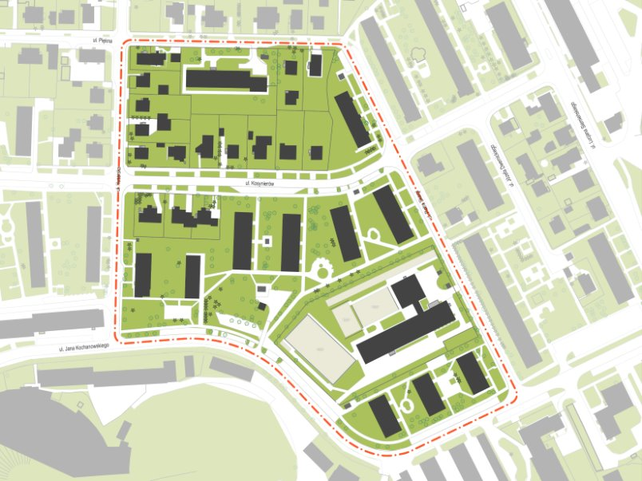
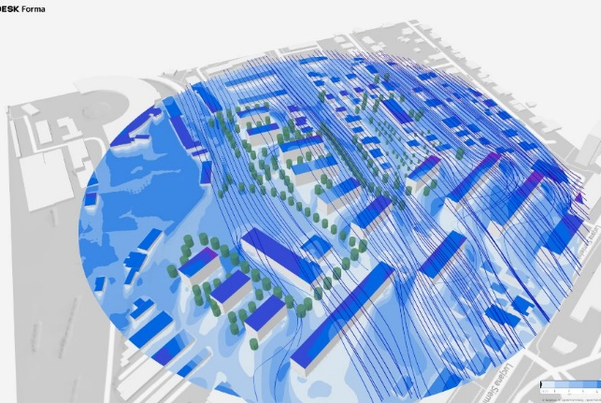
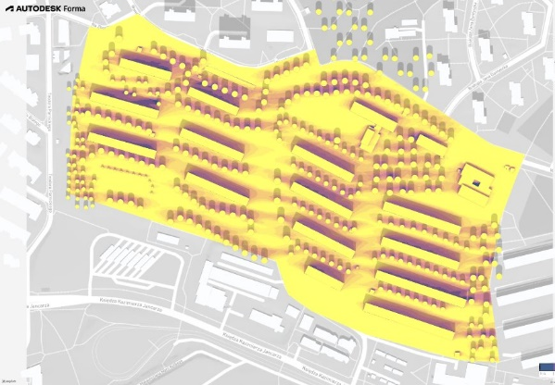
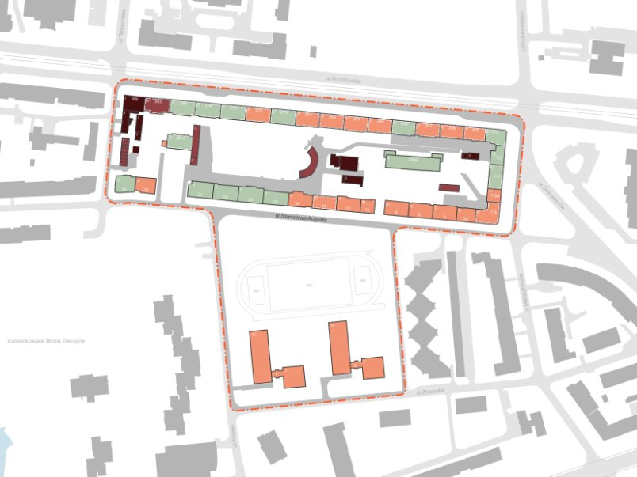
2nd German-Polish Energy Transition Forum, Berlin, 17th May 2024

Slide 4
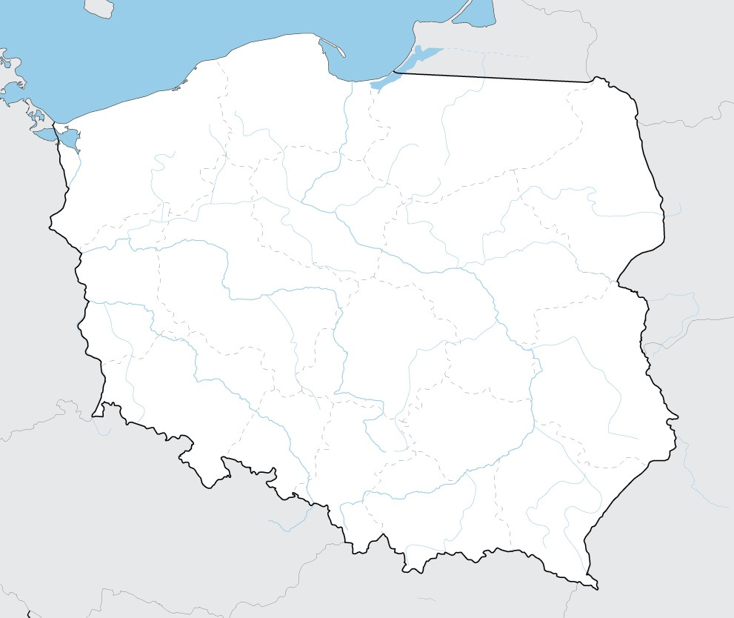
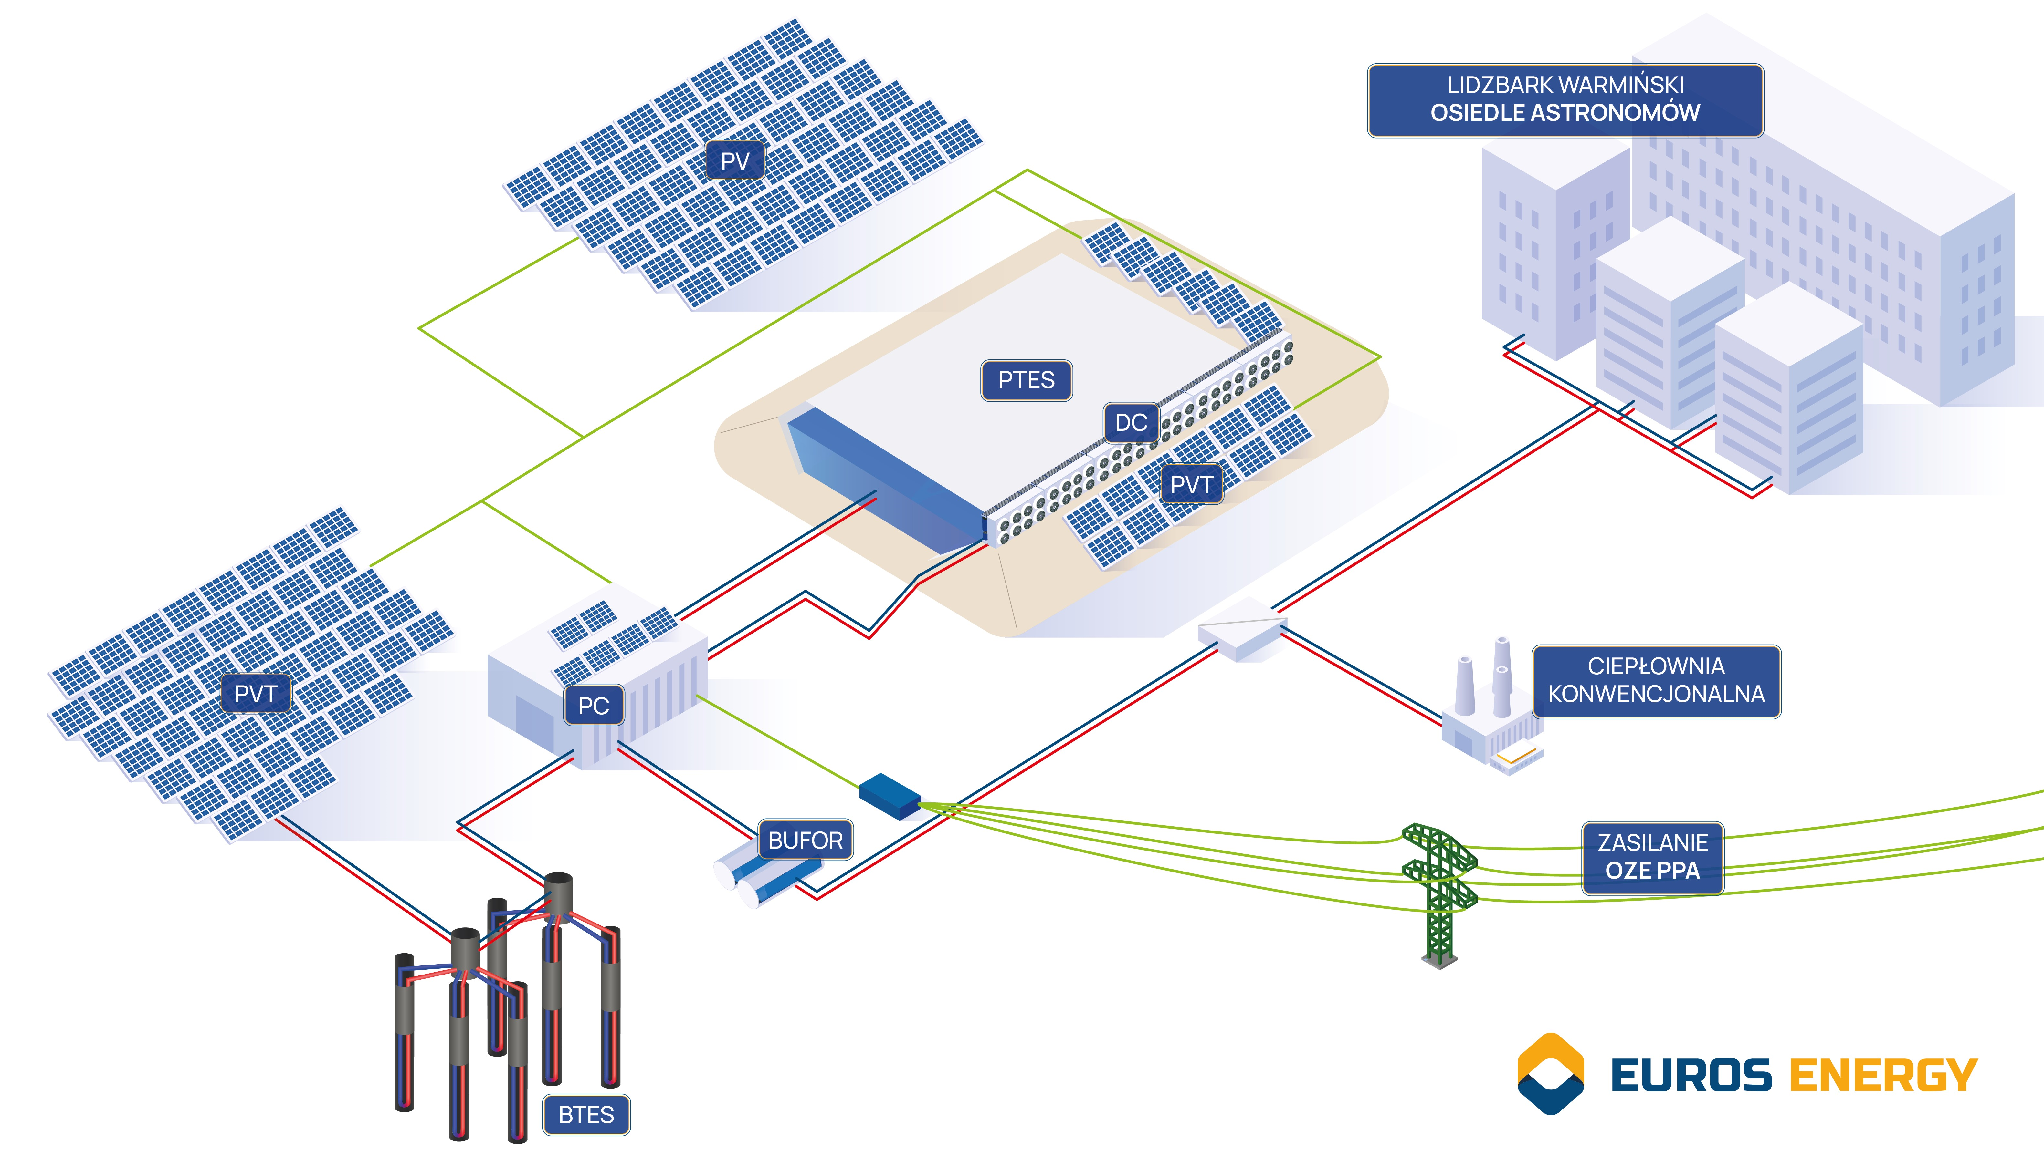
2nd German-Polish Energy Transition Forum, Berlin, 17th May 2024
100% RES PILOT PLANT IN LIDZBARK WARMIŃSKI
Lidzbark Warmiński
2,000 inhabitants
HEAT PUMP MACHINERY 2.6 MW
AIR-WATER HEAT EXCHANGER 1.7 MW
LOW TEMPERATURE BTES 1 GWh (5-20 °C)
HIGH-TEMPERATURE PTES 1 GWh (7-70 °C)
SHORT-TERM TES – BUFFER (85 °C)
LOCAL PV FARM 1.3 MW
HYBRID SOLAR COLLECTORS PVT 190 kW
Contractor: EUROS Energy
District Heating Company: Veolia term

Slide 5
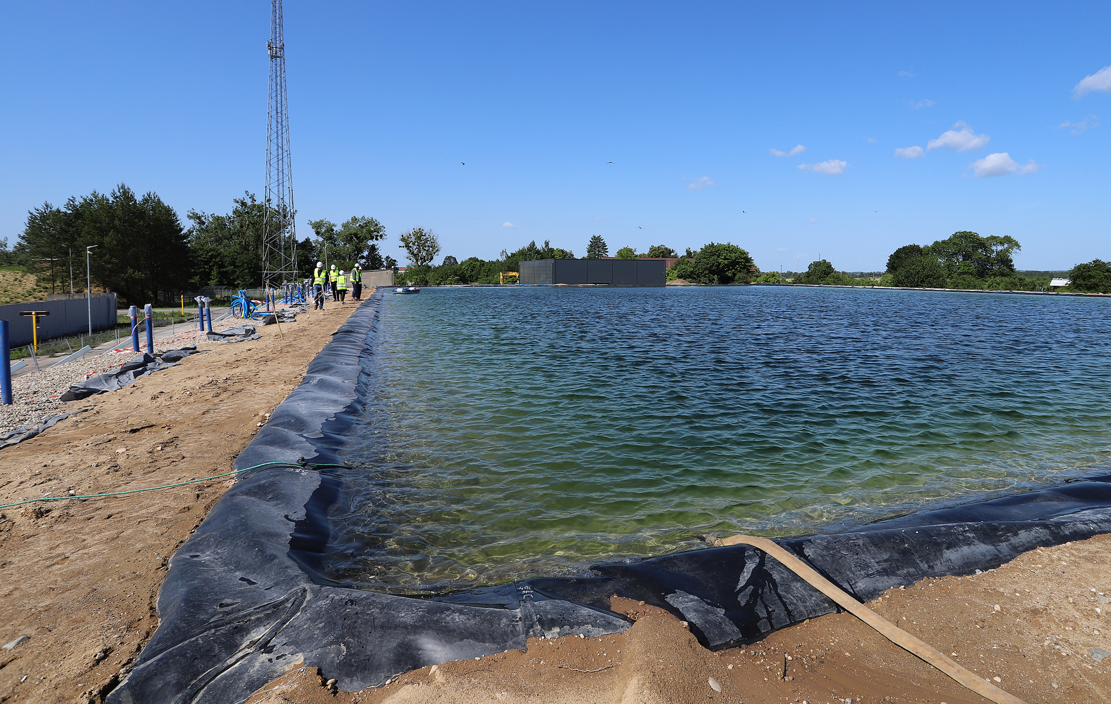
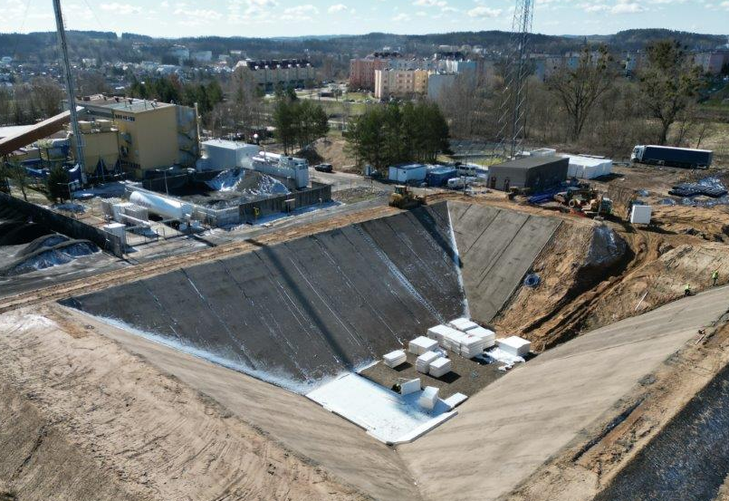
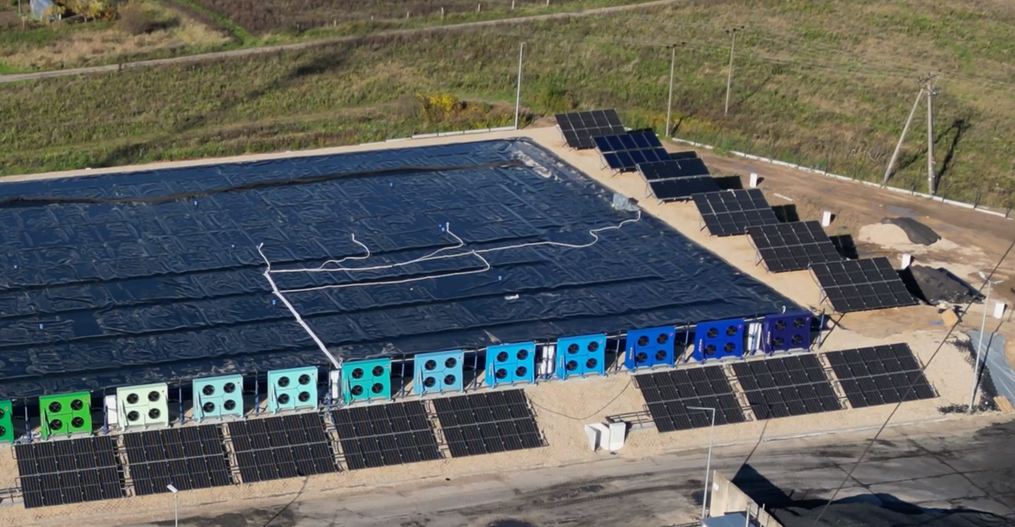
District heating plant of the future
2nd German-Polish Energy Transition Forum, Berlin, 17th May 2024

Slide 6
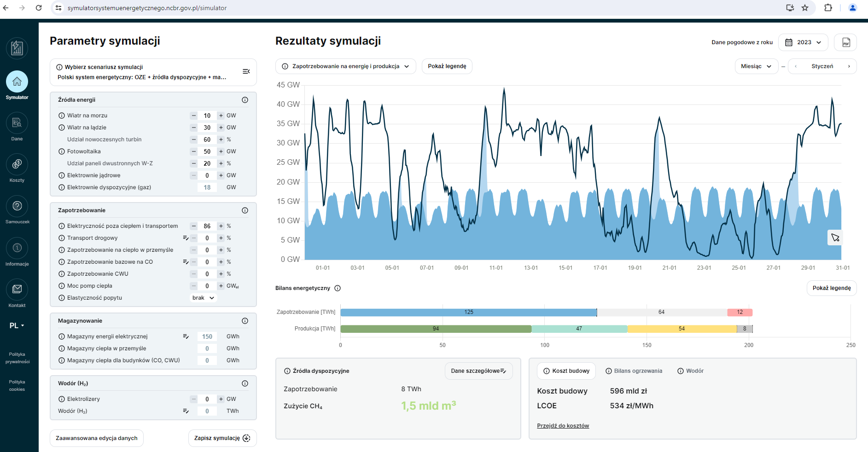
2nd German-Polish Energy Transition Forum, Berlin, 17th May 2024
Polish Power System Simulator
https://symulatorsystemuenergetycznego.ncbr.gov.pl/

Slide 7
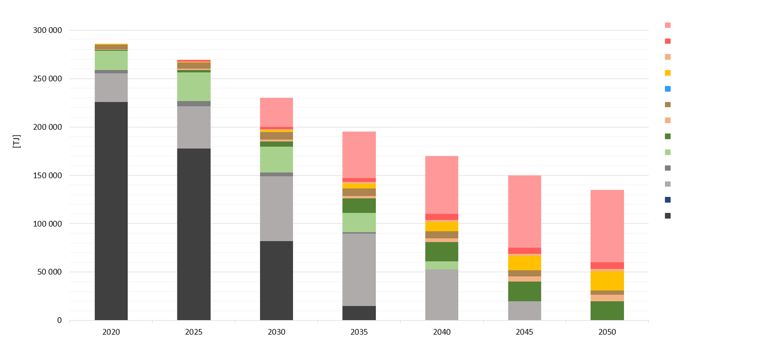
2nd German-Polish Energy Transition Forum, Berlin, 17th May 2024
STEP 2: Transformation of the Polish district heating – WAM NCBR scenario (With Additional Measures)
Heat pumps
Electrode electric boiler
Waste heat
H2 Heat
Waste Incineration Plant
Solar panels
Geothermal energy
Biogas
Solid biomass
Oil
Heat production
Natural gas
Popyt
Nuclear fuel
Coal
Years

Slide 8
2nd German-Polish Energy Transition Forum, Berlin, 17th May 2024
Supply
Demand
The transformation process will result in the need for many materials and systems (demand). Demand, in turn, will result in an increase in prices and a decrease in the quality of the solutions offered. To prevent this from happening, an appropriate production base of materials and systems (supply) must be created in advance. Only thanks to such a balance of demand and supply will the transformation process be able to be implemented in the right quality and for the right money.

Slide 9
Thank you!
Mariusz Skwarczyński
Heat Pump Project Manager
mariusz.skwarczynski@ncbr.gov.pl

